Slide 1
Meeting Week 4
Last week summary
ASMPT Specifications
OMNIPUS and alternatives
Simulation
  LPV and MIMO
Question 1
Question 2
Question 3
Outline ToDo next week

Slide 2
Last week summary
Combining Bas Kessels his Extension and Augmentation with Orthogonality Regularization
  Extension: New states are added to the model to capture unmodeled dynamics
  Augmentation: Existing state derivative and output equations of the FP model are augmented with NNs
  Orthogonality Regularization: Penalizes the neural network from learning dynamics explained by the FP model use State-Space
    Restricts the NN so it is forced to learn unmodeled "leftover" dynamics
    Preservers interpretability
Notes:
Similar to jan’s method

Slide 3
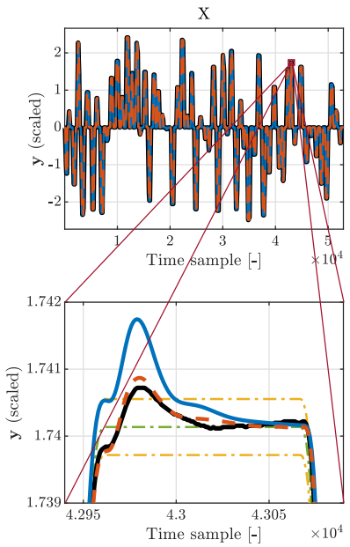
Last week summary
Key metric to design experiments around: settling error bounds
  Weighting function to tell the optimizer where accuracy matters → acts as prefilter
    Specify frequencies where accuracy matters most
  Proposed cost function instead of Feature selection from Kessels for the peaks
    Can we actually rule out Time Extremum (peaks and valley) features for dual-gantry?
Measured system – black
FP model – blue
EA model – red
Reference profile – green
Error bounds – yellow

Slide 4
Last week summary
Experiment design
  Wet-clutch “spike” signal to capture local dynamics
  OMNIPUS for global movement to cover full operating space

Slide 5
ASMPT Specifications - Decoupling
FP model decoupling
  Both coupled and decoupled FP model are available.
  Modal transformation decoupling:
The physical motor positions X1, X2 are transformed into two (approximately) independent modal coordinates:
    η1: translation/synchronous motion of the cross-arm
    η2: twist/rotational mode of the cross-arm
The decoupled FP model can be used in the feedforward. The feedback cannot be changed due to firmware constraints, so we assume the existing feedback bandwidth is sufficient

Slide 6
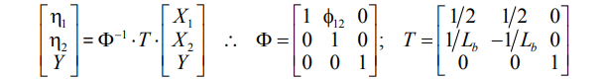
ASMPT Specifications - Decoupling
FP model decoupling
  Both coupled and decoupled FP model are available.
  Modal transformation decoupling:
  The physical motor positions X1, X2 are transformed into two (approximately) independent modal coordinates:
    η1: translation/synchronous motion of the cross-arm
    η2: twist/rotational mode of the cross-arm
The decoupled FP model can be used in the feedforward. The feedback cannot be changed due to firmware constraints, so we assume the existing feedback bandwidth is sufficient
(39)
“The feedforward control starts from the reference positions, velocities, and accelerations X1 ref, X2 ref, and Yref. These references are transformed into the equivalent decoupling basis references η1 ref, η2 ref and Yref, using (39)”

Slide 7
ASMPT Specifications - Decoupling
FP model decoupling
  Both coupled and decoupled FP model are available.
  Modal transformation decoupling:
  The physical motor positions X1, X2 are transformed into two (approximately) independent modal coordinates:
    η1: translation/synchronous motion of the cross-arm
    η2: twist/rotational mode of the cross-arm
The decoupled FP model can be used in the feedforward. The feedback cannot be changed due to firmware constraints, so we assume the existing feedback bandwidth is sufficient
(39)
“The feedforward control starts from the reference positions, velocities, and accelerations X1 ref, X2 ref, and Yref. These references are transformed into the equivalent decoupling basis references η1 ref, η2 ref and Yref, using (39)”
Notes:
modal transformation matrix (Φ−1)
purpose is to take the real-world, coupled physical coordinates of the gantry stage and mathematically transform them into a "decoupling basis“
Input vector (X1​, X2​, Y): These are the standard, measured position references for the physical actuators. X1​ and X2​ are the two parallel motors carrying the cross-arm, and Y is the motor carrying the payload
Row 1: Translation Equation (η1​=1/2​X1​+1/2​X2​)What to explain: By averaging the position of the two parallel actuators (X1​ and X2​), this equation calculates the exact center point of the cross-arm
Row 2: The Rotation Equation (η2​=1/Lb1​X1​−1/Lb​​X2​)What to explain: This equation calculates the difference in position between the two parallel actuators and divides it by Lb​ (the length of the moving cross-arm)
Physical meaning: Dividing the arc length (the difference in X) by the radius (Lb​) calculates the yaw angle (Θ). This isolates the pure rotation or twisting of the cross-arm about its own center of mass
Row 3: The Payload Equation (Y=Y)What to explain: The coordinate for the payload translation simply equals itself; the matrix multiplies it by 1 and ignores X1​ and X2​
Y does not need a new modal coordinate because it has already been "pre-decoupled“; feedforward anticipation.

Slide 8
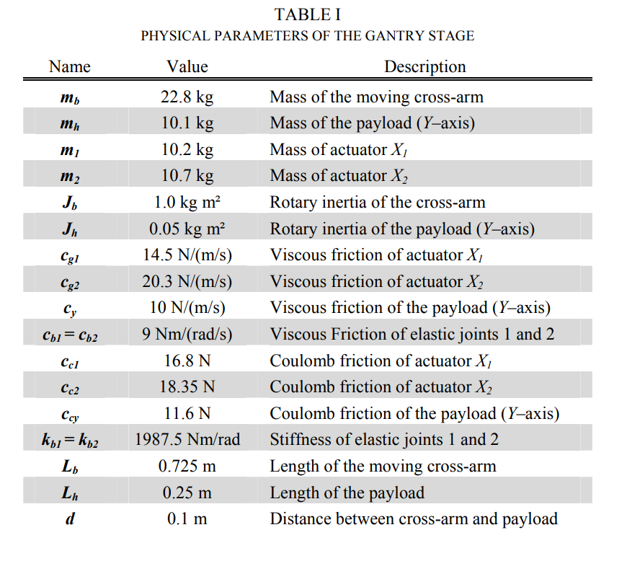
FP model
Entire decoupled FP model can be explained with parameters in table 1.
Experiments for parameters:
  Payload (Y-axis): To isolate the payload's parameters, the parallel actuators (X1​ and X2​) are physically blocked to prevent the cross-arm from rotating
  Synchronous Translation (X-axis):To identify the parameters of the main actuators, X1​ and X2​ are moved in perfect synchronization
  Rotation (Θ): To determine the parameters of the flexible joints and the cross-arm's rotary dynamics, the cross-arm is intentionally rotated
Notes:
“Recommended to repeat these experiments, seemed very doable”- ASMPT

Slide 9
ASMPT Specifications - Unmodeled dynamics
Settling error bound unknown vs hard-to-model
  Telica dual-gantry system will be replaced by Kamtin ; for Kamtin, the unmodeled dynamics are not yet known.
  For Telica, the dominant issue was mainly hard-to-model dynamics due to strong coupling (not specifically “nonlinearities”).
      Kamtin includes a vibration isolation system, can actively adjust/compensate

Slide 10
ASMPT Specifications - Feedforward
If the NN captures the “missing physics”: feedforward implementation
  Two option were proposed:
    Direct Inversion: invert augmented model to generate a more accurate reference force → not always possible for neural network
    Add-on Correction: neural network output as an additive “correction signal” on top of the existing feedforward?
  Either is fine, choose own preference

Slide 11
ASMPT Specifications - CT vs DT
Model needs to be implemented in DT
Mentioned that if a method is more promising in CT feel free to convert between CT and DT.
Notes:
Can you Jan’s DT methods.

Slide 12
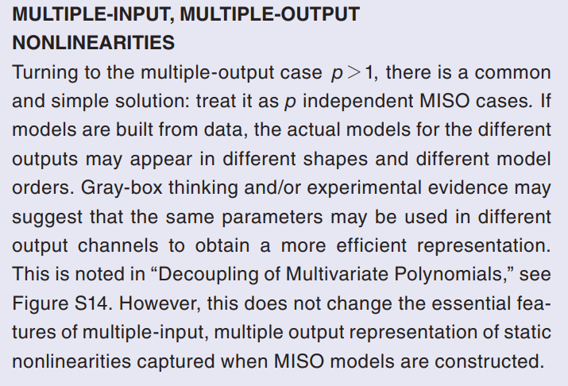
Experiment design - OMNIPUS for MIMO?
Book Schoukens: only discussed OMNIPUS in the context of MISO
Book provides a general principle for nonlinear system identification handles multiple outputs
For multiple outputs, we often just fit one MISO nonlinear model per output; the outputs may need different model orders, and sometimes we can share parameters across outputs for efficiency, but the basic MIMO behavior is already captured by the set of MISO models

Slide 13
OMNIPUS with constraints

Slide 14
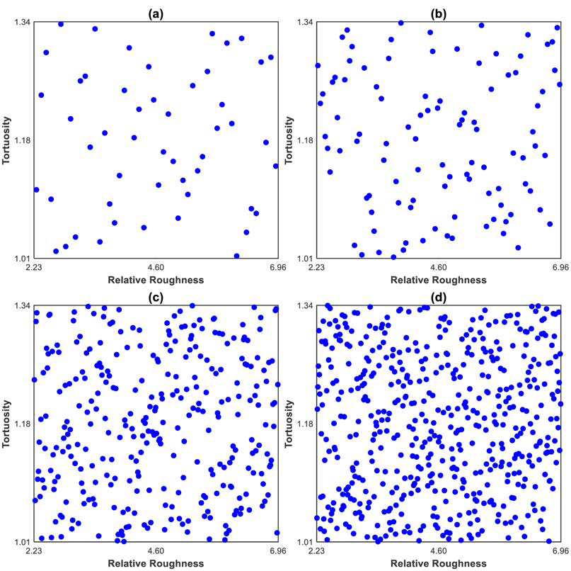
Latin hyper Cube sampling
Latin Hyper Cube (LHC) sampling.
  More a uniform distribution, doesn’t look into finding regions of high information density for capturing dynamics of the system
Latin Hypercube Sampling with different numbers of realizations

Slide 15
Alternatives to OMNIPUS
For the dual-gantry system need a method that keeps collisions and thus input constraints into account for global excitation.
  MIMO methods designed for this?
iGOAT improvement over OMNIPUS
  iGOATS and OMNIPUS are capable to incorporates constraints
  OMNIPUS limitation: For a multi-input (MIMO) system, OMNIPUS lacks the "degree of freedom" to optimize multiple inputs at once. In every iteration, it optimizes only one amplitude of one input
iGOAT (incremental Genetic Optimized Amplitude Time Signal)
  Demonstrated on a two-dimensional artificially created nonlinear dynamic system
  iGoats builds on Latin Hyper Cube (LHC) sampling
  Method:
    Each iteration, it uses a genetic algorithm to optimize a short subsequence of amplitude levels and durations, which it then appends to the existing signal
    Simultaneous Multi-Input Optimization: optimizes the subsequences for every input dimension of the system at the exact same time
    Planning Feature: looks ahead by considering multiple subsequent steps
Paper: Space-filling Optimization of Excitation Signals for Nonlinear System Identification
Notes:
However, got recommended to first start with one guantry
The excitation signal should also comply with the constraints imposed by the process (that is, restrictions on the amplitude level and signal gradients)
The OMNIPUS’s major advantage is its incremental design so that the subsequences of the signal are space-filling. The GOATS’s main advantage is its high degree of freedom due to the utilization of a global approach. Unfortunately, with the advantage of the OMNIPUS also comes the disadvantage of a lack in the degree of freedom. That is, in every iteration, OMNIPUS optimizes only one amplitude of one input. To overcome this limitation and to weaken the resulting disadvantage of previous suboptimal optimized sequences, an incremental version of the GOATS (iGOATS) is developed by considering a bigger and more complex subsequence inside one iteration.
The OMNIPUS Bottleneck: OMNIPUS suffers from a "lack in the degree of freedom" because it can only optimize one amplitude of one input at a time during each iteration

Slide 16
Alternatives to OMNIPUS
Receding Horizon Control (RHC)
  Online and Offline Space-Filling Input Design for Nonlinear System Identification: A Receding Horizon Control-Based Approach
Gaussian Process (GP)
  On Space-Filling Input Design for Nonlinear Dynamic Model Learning: A Gaussian Process Approach
Notes:
On Space-Filling Input Design for Nonlinear Dynamic Model Learning: A Gaussian Process Approach
Online Kernel-Based Methods
DSS (Direct Spectrum Shaping): An online input design method formulated around the biased Cramér–Rao lower bound. It optimizes the signal one bit at a time on the fly, offering very low computational costs suitable for systems with fast dynamics
BAO (Bayesian A-optimality): Another online input design technique that minimizes the posterior uncertainty of the frequency response. It typically attains higher estimation accuracy for oscillatory systems but requires significantly higher computational time than DSS

Slide 17
RHC-Based Space-Filling Input Design for Nonlinear Systems
Problem: Standard input designs largely overlook the generalization error, which causes model inaccuracies in unexplored operating regions
Solution: optimization framework that induces a "space-filling" design to actively drive the system to cover a user-defined region of interest, ensuring comprehensive data collection and minimizing knowledge gaps
  Iterative RHC Strategy: iteratively predict and optimize future input sequences over a finite prediction horizon
Paper: Online and Offline Space-Filling Input Design for Nonlinear System Identification: A Receding Horizon Control-Based Approach
Notes:
Can be executed Offline (using a fixed, coarse surrogate model) or Online (adaptively updating the model as data is collected)
Introduction & The Problem "This paper addresses a major flaw in traditional data-driven modeling: the generalization error. If our excitation signal doesn't visit a specific region of the operating space, our nonlinear model will likely fail in that region. We need a signal that explicitly explores everywhere."
The Methodology "To solve this, the authors propose a 'space-filling' design. Instead of just injecting random noise, they use a Receding Horizon Control (RHC) optimization framework. Essentially, the algorithm looks at the data points it has already collected, looks at a grid of target 'anchor points' distributed evenly across the desired operating space, and mathematically calculates the optimal next inputs to fill in the empty gaps."
Why it Matters for Our System (Safety & Flexibility) "There are two massive benefits to this approach for our specific needs. First, because it uses RHC, we can define strict, mathematical hard constraints on both the inputs and the system states. This guarantees the system will not try to drive into a physical collision or a blocked region. Second, it is highly flexible; we can run it purely offline using a rough baseline model, or we can run it online so it adapts its exploration as it learns the true system dynamics."
Conclusion "Ultimately, the paper proves that this method significantly outperforms standard excitation signals—like APRBS—in uniformly mapping a nonlinear system's dynamics, resulting in a robust model that generalizes safely across the entire operational envelope."

Slide 18
Distance-Based Optimality: algorithm calculates the nearest-neighbor distance between the excitation signal's actual data points and an ideal "target map" within the model's input space.
  By actively minimizing this total distance, it systematically forces the system to fill empty regions
Target Map Initialization: ideal target map is generated before optimization, distributes uniform points across region of interest
Online Adaptation: target map's coordinates remain fixed, running the method online continuously updates the underlying model parameters
  Target Map is made of both Inputs and Outputs, by updating the output the RHC algorithm is better able to look ahead to plan a sequence of future inputs (over a specific horizon).
Notes:
(using Sobol sequences

Slide 19
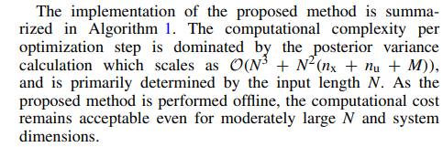
On Space-Filling Input Design for Nonlinear Dynamic Model Learning: A Gaussian Process Approach
Instead of actively searching for areas of high uncertainty, use GP variance purely as a mathematical tool to spread data out
Grid desired operational area with predefined target coordinates called "anchor points“
Forcing the GP posterior variance at these exact anchor points to zero, the input signal is compelled to steer the physical system into every defined corner
Mathematical Guarantee: If the variance at anchor points drops, the entire region has been uniformly explored
Dual gantry system will have a high-dimensional input-state space:
Notes:
First state space model of the dual gantry → FP
Define the Region of Interest (ROI) via Physical Considerations You do not place anchor points randomly across all mathematical possibilities. Instead, you define your ROI based strictly on "physical considerations"

Slide 20
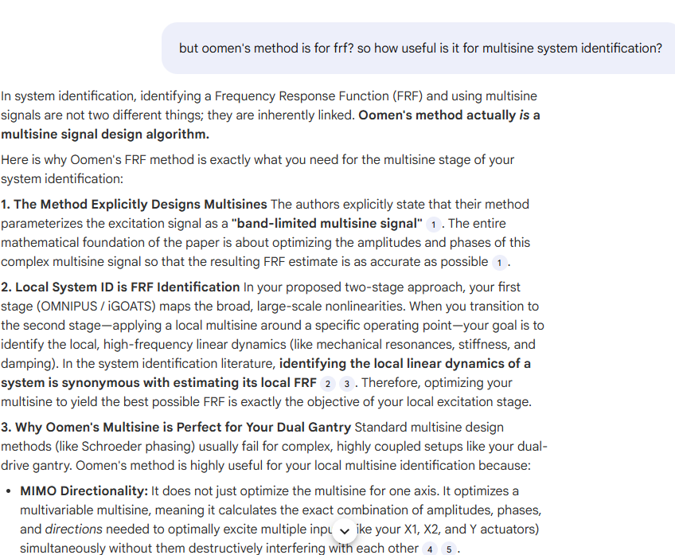
Multisine input signal design for constraint
The Nonlinearities: Friction, detent forces, and varying payload dynamics depending on the position of the Y-axis.
Oomen’s method is not meant to map the global friction or detent forces; that is what your first stage (e.g., GP space-filling or iGOATS) is for. Instead, Oomen’s method is specifically designed to unravel that MIMO mechanical coupling
Tom Oomen multisine constraint?:
Use smoothing-based l∞​-norm optimal multisines for your local high-frequency excitation, because that algorithm was explicitly built and experimentally validated on a highly coupled MIMO motion system
The entire mathematical foundation of the paper is about optimizing the amplitudes and phases of this complex multisine signal so that the resulting FRF estimate is as accurate as possible
In the system identification literature, identifying the local linear dynamics of a system is synonymous with estimating its local FRF
Therefore, optimizing your multisine to yield the best possible FRF is exactly the objective of your local excitation stage.
MIMO Directionality: It does not just optimize the multisine for one axis. It optimizes a multivariable multisine, meaning it calculates the exact combination of amplitudes, phases, and directions needed to optimally excite multiple inputs (like your X1, X2, and Y actuators) simultaneously without them destructively interfering with each other
In Tom Oomen's multivariable optimal experiment design, phase shifts preserve MIMO directionality by exploiting the mathematical non-uniqueness of the optimal power spectrum solution
Paper: Peak Amplitude-Constrained Experiment Design for FRF Identification of MIMO Motion Systems

Slide 21
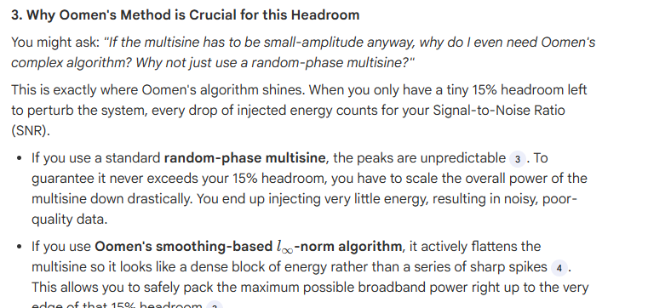
Combining Oomen’s method with Wet-Clutch trick

Slide 22
Designing positive excitation signals for the safe identification of nonlinear integrating systems

Slide 23
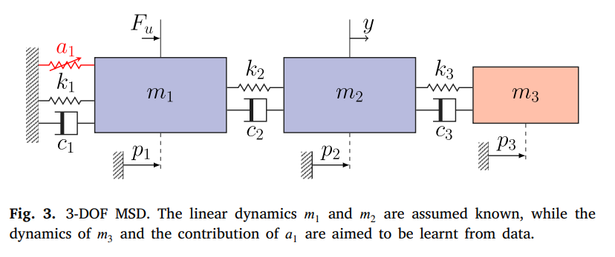
Simulation – Setup Jan
Need to adjust simulation section to incorporate LPV and MIMO methods into current simulation structure.
Mass Spring Damper system: dynamics of the third (red) mass block and a nonlinear cubic spring (a1) attached to the known modeled system.
Baseline Model: The code assumes we only have an imperfect, simplified physical model: linear 2-DOF system that only takes the first two masses into account

Slide 24
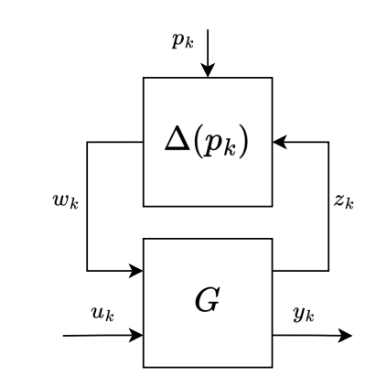
Adapt simulation code for MIMO & LPV
Need to adapt the current SISO code to work for MIMO and adapt it to work for Linear Parameter Varying (LPV)
LPV
  LPV-LFR (the physics): Separates the system into a baseline linear model and a parameter-varying “delta block" (Δ(pk​)). The delta block continuously shifts the linear model's equations to capture nonlinear behavior
  Scheduling Map Network (NN): Additional Neural Network does not predicts the physical dynamics directly. Instead acts as a "conductor."
    Input: It observes the current environment (states, inputs, and exogenous signals).
    Output: It outputs dynamic tuning dials (scheduling variables, pk​)
    Result: These pk​ variables are fed directly into the delta block, telling the LPV-LFR model exactly how to adjust its physics for that time step
    (can still have another NN augmentation in parallel/series predicting residual dynamics)

Slide 25
MIMO code extension for Wafer
Received extension from Jan’s LFR code to MIMO
Subnet Encoder: At the start of every training window, an encoder neural network uses a short history of past inputs and outputs to estimate the initial state. For MIMO (multiple sensors/actuators), the encoder input layer must be large enough to include all channels.
Current SISO structure: The output-dimension variable ny is hardcoded to an empty tuple “()”. This prevents the encoder input from scaling with the number of outputs and effectively removes the output-history term.
Extension to MIMO: One-line fix in interconnect.py. By enabling the dynamic tuple logic, ny is inferred from the dataset so the encoder automatically builds the correct input size: nb * nu + na * ny. We also swap the default encoder class to keep the wrapper clean and fully MIMO-capable.
Adapt for benchmark MIMO or dual-gantry: Replace the hardcoded 1D physics blocks with generic state-space blocks whose input/output dimensions match the MIMO plant
Notes:
Swapping the default to default_encoder_net does two practical things:
Removes the risk of reintroducing SISO-only tweaks via the custom encoder being used implicitly.
Makes MIMO the default behavior: if sys_data.ny>1, the default deepSI encoder will size itself correctly without relying on your local fixes.
Interconnect (in interconnect.py) is the “wiring + execution engine” that turns a set of blocks into one closed state-space model step.
, ensure data pipeline feeds multi-column arraysand widen our data routing matrices so all gantry channels flow through the switchboard simultaneously."
* **The Context:** "To use Jan Hoekstra's model-augmentation codebase for our dual-gantry system, we had to enable MIMO capabilities within the SUBNET-style encoder wrapper. The issue wasn't in the LFR math itself, but in how the encoder ingests past data to guess the initial state."
* **Explain the Bug:** "In the public repository, the developer hardcoded the output dimension variable (`ny`) to an empty tuple. This doesn't just fail to scale the network; it effectively removes the output-history term entirely. Because the network expects zero output features, but the code still tries to feed it our multi-sensor gantry data, it immediately throws a dimension mismatch error."
* **Explain the Fix:** "The fix is a precise one-line code change in `interconnect.py`. Instead of an empty tuple, we evaluate `ny` dynamically so the encoder's input layer automatically matches the number of outputs in our dataset. We also clean up the architecture by defaulting to deepSI's natively MIMO-safe encoder."
* **Explain the System Implementation:** "With the core engine fixed, adapting the rest to our dual-gantry system just requires swapping out the hardcoded 1D physics blocks for appropriately dimensioned generic state-space blocks where the number of inputs and outputs are strictly greater than one."

Slide 26
MIMO code extension for Wafer
In interconnect.py, SSE_Interconnect uses an encoder to estimate the initial state from a history of past inputs/outputs. For MIMO, its input size must scale with `ny` (all output channels).
Why currently SISO
  The `modified_encoder_net` class hardcodes `self.ny = tuple()`.
* **The Result:** The network is built as if there are **0 output features**. However, `ypast` is still flattened and concatenated during the forward pass. When `ny > 1`, the input size no longer matches the first layer, causing a dimension mismatch.
**3. What Was Changed to Make it MIMO-Capable**
* **The Code Fix:** Changed the hardcoded line to correctly read the output channels:
`self.ny = tuple() if ny is None else ((ny,) if isinstance(ny,int) else ny)`
* **Default Cleanup:** Swapped the default encoder in `SSE_Interconnect` to `default_encoder_net` (deepSI) instead of the SISO-biased custom encoder.
**4. Adapting for the Dual-Gantry Benchmark**
* **Block Swaps:** Use MIMO-dimensioned blocks (Generic state-space blocks $A, B, C, D$ where $nu > 1, ny > 1$).
* Avoid/replace 1D physics blocks that hardcode $nu=1$ or $ny=1$.
Notes:
* **The Context:** "To use Jan Hoekstra's model-augmentation codebase for our dual-gantry system, we had to enable MIMO capabilities within the SUBNET-style encoder wrapper. The issue wasn't in the LFR math itself, but in how the encoder ingests past data to guess the initial state."
* **Explain the Bug:** "In the public repository, the developer hardcoded the output dimension variable (`ny`) to an empty tuple. This doesn't just fail to scale the network; it effectively removes the output-history term entirely. Because the network expects zero output features, but the code still tries to feed it our multi-sensor gantry data, it immediately throws a dimension mismatch error."
* **Explain the Fix:** "The fix is a precise one-line code change in `interconnect.py`. Instead of an empty tuple, we evaluate `ny` dynamically so the encoder's input layer automatically matches the number of outputs in our dataset. We also clean up the architecture by defaulting to deepSI's natively MIMO-safe encoder."
* **Explain the System Implementation:** "With the core engine fixed, adapting the rest to our dual-gantry system just requires swapping out the hardcoded 1D physics blocks for appropriately dimensioned generic state-space blocks where the number of inputs and outputs are strictly greater than one."

Slide 27
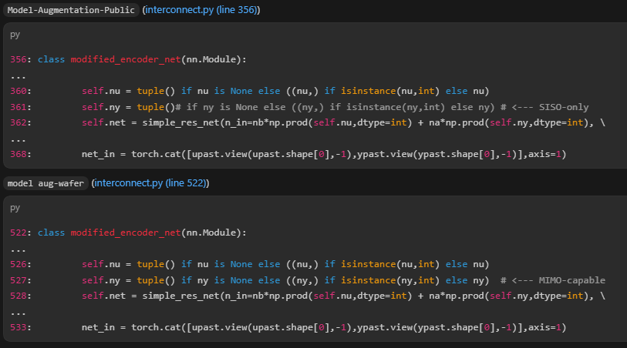
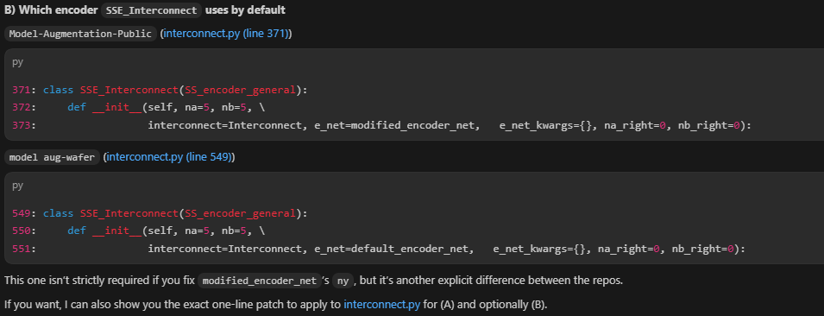
Model-Augmentation-Public (interconnect.py (line 356))
356: class modified_encoder_net(nn.Module):
...
360: self.nu = tuple() if nu is None else ((nu,) if isinstance(nu,int) else nu)
361: self.ny = tuple()# if ny is None else ((ny,) if isinstance(ny,int) else ny) # <--- SISO-only
362: self.net = simple_res_net(n_in=nb*np.prod(self.nu,dtype=int) + na*np.prod(self.ny,dtype=int), \
...
368: net_in = torch.cat([upast.view(upast.shape[0],-1),ypast.view(ypast.shape[0],-1)],axis=1)
model aug-wafer (interconnect.py (line 522))
522: class modified_encoder_net(nn.Module):
...
526: self.nu = tuple() if nu is None else ((nu,) if isinstance(nu,int) else nu)
527: self.ny = tuple() if ny is None else ((ny,) if isinstance(ny,int) else ny) # <--- MIMO-capable
528: self.net = simple_res_net(n_in=nb*np.prod(self.nu,dtype=int) + na*np.prod(self.ny,dtype=int), \
...
533: net_in = torch.cat([upast.view(upast.shape[0],-1),ypast.view(ypast.shape[0],-1)],axis=1)

Slide 28
Model augmenation
Model augmentation: combines the simplified physics model with Artificial Neural Networks (ANNs) to bridge the gap between data and FP model
  Adds two new mathematical states to the baseline model for the missing third mass
  It uses neural networks to learn only the unmodeled dynamics. Prevents this with Parameter Regularization: penalizes the model if the parameters of the baseline physics model (the known masses and springs) drift too far from their initial values
  LFR Structure: Connects the neural networks and the physical model using a Linear Fractional Representation (LFR) structure
    Allows to operate in parallel or series

Slide 29
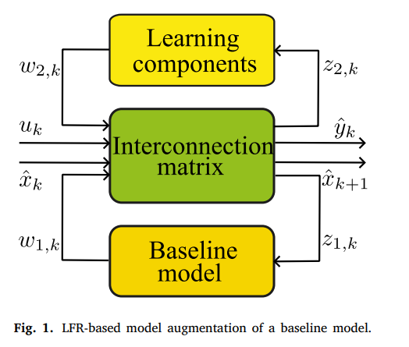
Linear Fractional Representation (LFR)
Kijken hoe aan te passen naar LPV-LFR
Learning components = neural network
Interconnection matrix: acts as routing switchboard, determines how the physics and NN interact with each other
LFR switchboard: at each time step
  Inputs: takes the current state of the system (x^k​), the external force/input (uk​), and the outputs generated by both the physics model (w1,k​) and the neural networks (w2,k​)
  Routing: Based on matrix configuration, it decides what signals to feed back into the physics model (z1,k​) and what signals to feed into the neural networks (z2,k​) for the next calculation
  Output: combines all these signals to calculate the system's overall next state (x^k+1​) and the predicted output (y^​k​)

Slide 30
Interconnection Matrix (S)
Only job of S is to direct the flow of the data between the physical model and the neural network
Parallel (allows to use orthogonality)
  S treats the physical model and the neural network as two independent workers tackling the same problem at the same time
  ANN learns the residual dynamics missing from the baseline
  Outputs simply added together
Series (sequential, not acting independently)
  S first sends the current state and input only to the physics model → routes this output directly into the neural network as its inputs
  ANN learns a correction map on top of the baseline’s predicted next-state, rather than an additive residual

Slide 31
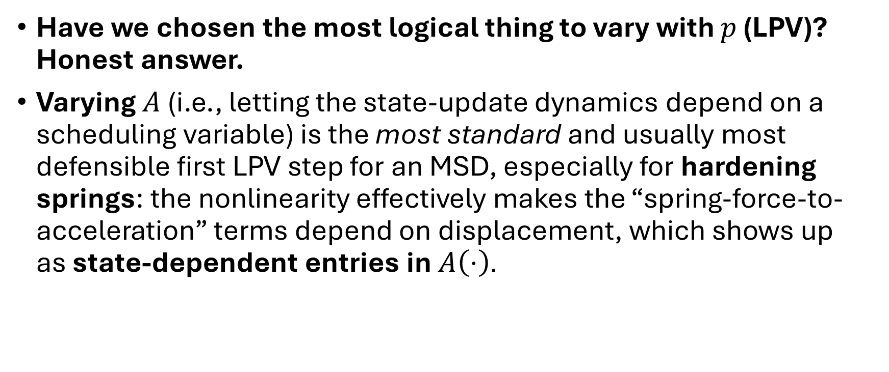
Adapt to Linear Parameter Varying (LPV)
Have we chosen the most logical thing to vary with $p$ (LPV)? Honest answer.
Varying $A$ (i.e., letting the state-update dynamics depend on a scheduling variable) is the most standard and usually most defensible first LPV step for an MSD, especially for hardening springs: the nonlinearity effectively makes the “spring-force-to-acceleration” terms depend on displacement, which shows up as state-dependent entries in $A\left(⋅\right)$.

Slide 32
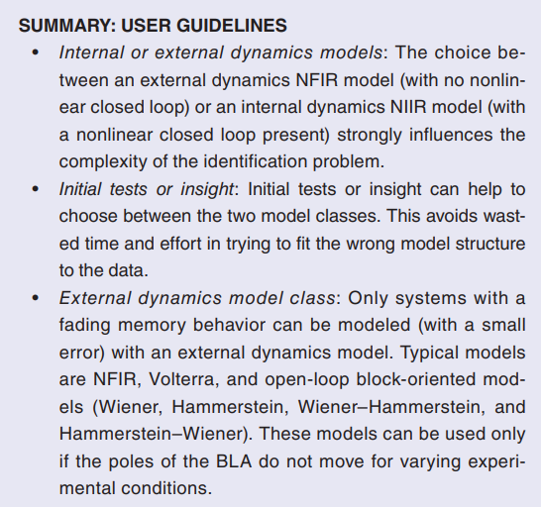
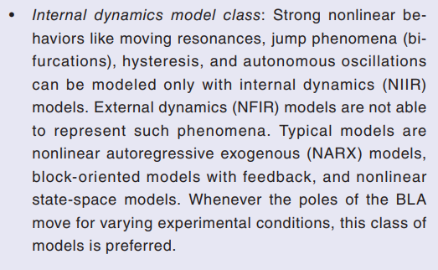
Nonlinear Infinite Impulse Response (NIIR)
third type of model mismatch is missing states. In this case, the physical system exhibits dynamical behavior that operates on additional, different timescales (or for linear systems; eigenfrequencies) than those already present in the FP model. These may be caused by, among others, flexible dynamics and parasitic degrees of freedom. To account for this type of model mismatch, completely new states are required, which also require their own governing dynamical state equations, i.e., state extension is applied. To this end, again, NNs are employed.
The governing dynamical state equations are captured by separate NNs. Here, we have the choice to use physical knowledge and assume that these equations take on a second-order structure to limit the workload of the neural network. In this chapter, we indeed will assume a second-order structure for the extended states.
"Internal Dynamics"—specifically unmodeled resonances or flexible modes-that cannot be represented by a simple history of inputs
The most direct justification is that the physical phenomena you are trying to learn (e.g., flexible modes of the gantry) have their own "memory" or inertia.
Notes:
• Concept: Kessels defines these unmodeled phenomena as "missing states". A state, by definition, summarizes the past history of the system [Source 5, 206].
• Justification: If you simply map Input → Output (Feedforward), you assume the system reacts instantly or with a fixed finite delay. However, a flexible mode continues to oscillate after the input has stopped. To model this, the system must know its current status (position/velocity of the vibration) to calculate its next step.

Slide 33
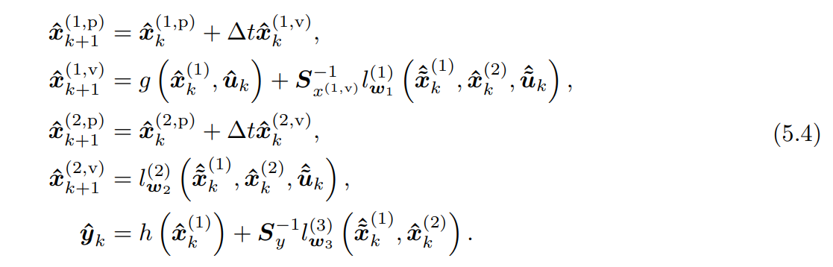
lw(i) represents a feedforward nn parameterized by weights w
Calculates how the system changes from one time step to the next
Since for a simulation, l (1) w1 , l (2) w2 , and l (3) w3 are used recurrently in sequential time steps, they are regarded as Recurrent Neural Networks (RNNs)
The "recurrent" label comes from where l is placed in the equations, not the internal architecture of the network itself. l acts as the state transition function (or discrete vector field) for the augmented parts of the model.
Update Xk+1 and update lw based on states. So why update twice?
The 3 l’s are trained static mapping. Feed forward nn, but because these 3 nn (l’s) keep looping back in (the total picture where all 3 are combined). He calls it a RNN. So for the augmentation step the l’s are a static mapping
Kijken hoe de l’s precies getraint.

Slide 34
3. Specific Roles of each l function
Kessels defines three distinct l functions, each serving a different purpose in the Extension and Augmentation (EA) model [Source 5, 343, 344]:
• lw1​(1)​ (Augmentation):
◦ Job: Corrects the known physics.
◦ Action: It calculates a "correction force" that is added to the standard First Principles equation (g). For example, if the FP model predicts friction incorrectly, l(1) learns to output the missing friction force.
• lw2​(2)​ (Extension):
◦ Job: drives the new physics.
◦ Action: It acts as the entire physics engine for the "missing states" (like flexible modes). It calculates the acceleration of these invisible states based on the system's current motion.
• lw3​(3)​ (Output Correction):
◦ Job: Corrects the sensor reading.
◦ Action: It maps the internal states to the measured output. If the sensor has a nonlinearity not modeled by h, l(3) adds a correction value to the output y^​.

Slide 35
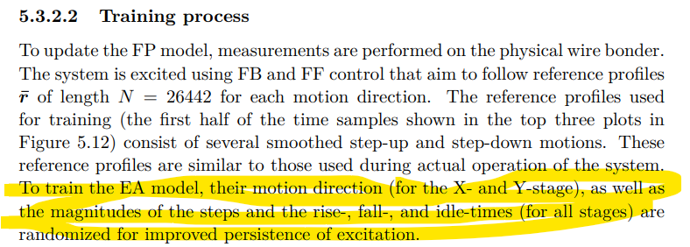
Global movement
OMNIPUS responsible for global movement for covering the full operating space. Combine with “Wet-Clutch Trick” for local excitation
OMNIPUS was for three inputs and one output → MIMO
MIMO nonlinear sytem identifciation literature.Compare to how Kessels did it.
  The "OMNIPUS" Aspect: Instead of using a fixed repetitive cycle, Kessels explicitly randomizes the "motion direction... as well as the magnitudes of the steps".
OMNIPUS: As described in Source 0, OMNIPUS involves an optimization routine (often brute-force) to select the specific sequence of steps that maximizes the information content (Fisher information matrix)
Hoe experiment voor dual gantry. Hoe houd je rekening met dat het systeem niet botst. Kunt niet omnipus gwn random steps. Constrain the inputs, of iets slimmers?

Slide 36
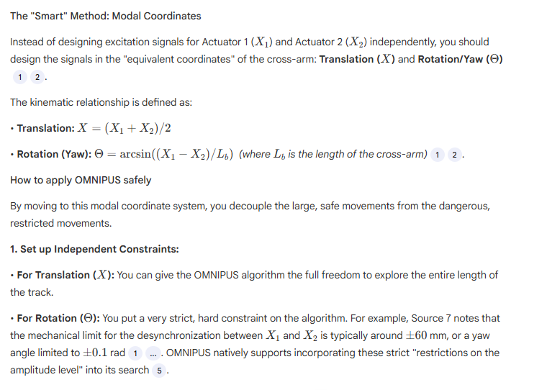
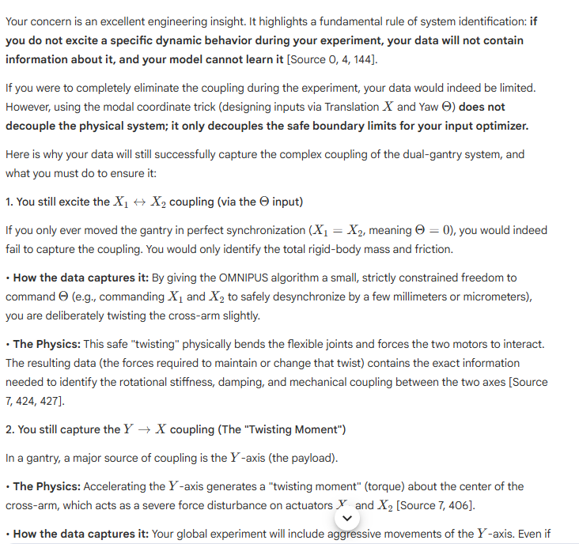
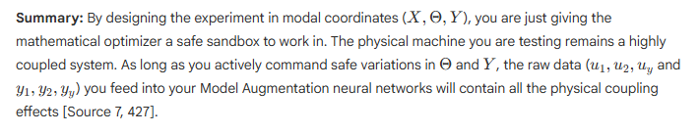
The thing is i have two gantries (its a dual gantry system). So i cant just use omnipus i need an algorithm/method that keeps in mind they gantries can physically collide. So either i need to put constraints on the inputs, but this limits the search algorithm, or i need a smart algorithm that keeps this in mind.
But I cannot just ignore the coupling… so modal transformations don’t seem to be the solution…

Slide 37
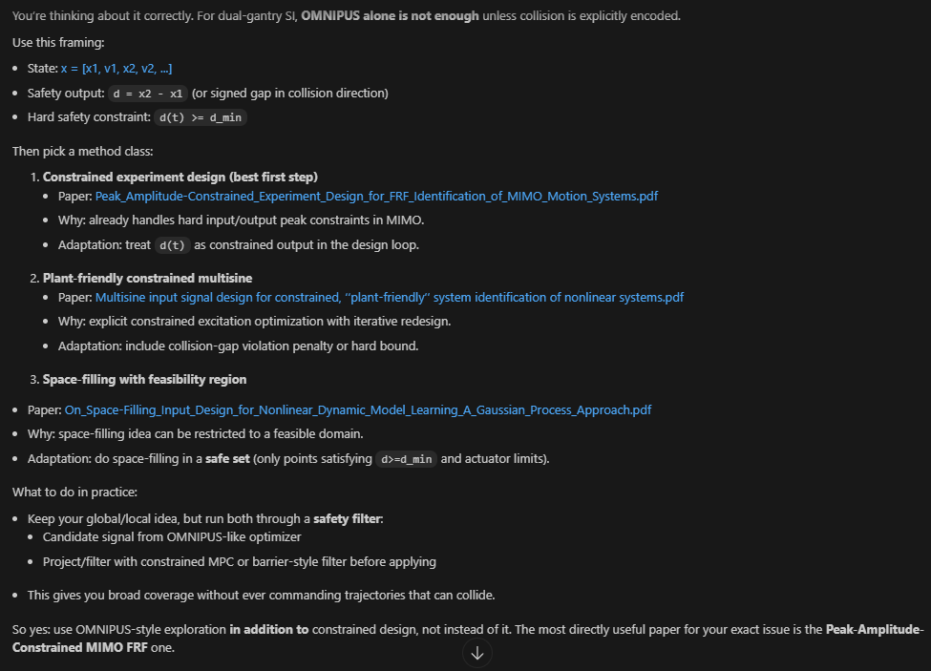
but if i just use a "filter" on the omnipus the algorithm might not cover all the space and miss important dynamics during training. so I should have a smarter method than just constraining the inputs.

Slide 38
Usefulness for your case:
Peak_Amplitude-Constrained...: very useful globally for safe MIMO FRF campaigns (include collision-gap as constrained output).
Multisine plant-friendly...: useful globally/semi-global for constrained nonlinear excitation design.
On_Space-Filling...: useful globally for coverage strategy, but only after embedding your safe feasible set.
Designing positive excitation...: situational; useful if you have one-sided actuation/drift-like constraints, otherwise secondary.
And yes:
Use the above as global safe excitation framework.
Then use a wet-clutch-style local excitation/refinement near critical regions (small gap, high coupling, resonance zones, endpoint trajectories).
So your proposed architecture is solid:
Safe constrained global design.
Targeted local refinement for high-sensitivity dynamics.

Slide 39
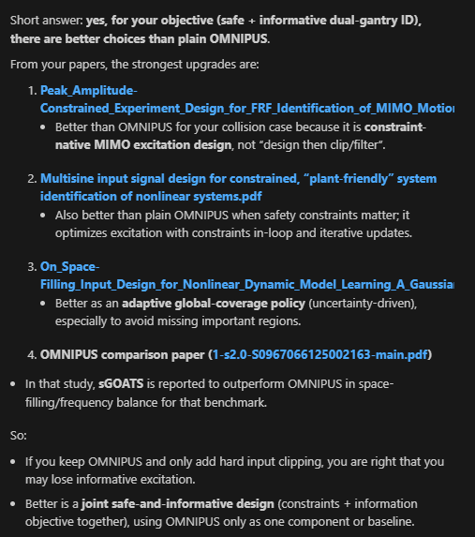
Better than OMNIPUS for dual-gantry
Problem with OMNIPUS: limit constrains
  Could use modal decoupling for inputs → still triggers coupled dynamics? Do I have a paper for this?
If we limited the inputs to OMNIPUS which does work for MIMO because: …
Just constraining the inputs might miss important dynamics, smarter methods:
    Analysis of space-filling excitation signals and dynamic models for nonlinear
    system identification of dynamic processes of a Diesel engine. Finds sGoats to be better but this is not a coupled system → should I do comparative excitation study? → better to pick one or two, since that is not the main goal of my project…
    → Pick a literature-backed safe default for global data collection. Goal of the project is model augmentation / grey box

Slide 40
Constrained MIMO FRF excitation design as the base
Use Peak_Amplitude-Constrained_... style design (hard/penalized output constraints, including inter-gantry distance).
This is better than “OMNIPUS + constraints” because safety is in the optimizer, not added afterward.
Apply in decoupled/modal coordinates
Keep modal decoupling, but only as a coordinate transform for better conditioning.
Decoupling alone is not enough; constrained OED is still needed.
Add sequential space-filling inside the safe set
Use On_Space-Filling... / 2504.02653v2 logic to pick the next experiments where uncertainty is high but collision-safe.
This avoids missing global dynamics while staying safe.
So the better approach is:
Constrained MIMO multisine OED + modal-coordinate implementation + sequential safe space-filling refinement
This is stronger than either:
OMNIPUS with clipped constraints, or
modal decoupling alone.

Slide 41
Global methods justification dual-gantry
Like OMNIPUS
Space-filling-Optimization-of-Excitation-Signals-for-Nonlinear-System-Identification
What you can claim strongly
OMNIPUS/GOATS-style methods improve global nonlinear identification data quality via space-filling excitation compared to standard signals (APRBS/chirp/multisine).
The method is formulated in a joint input/output regressor space, so it is methodologically compatible with multivariable systems.
What you should not claim strongly
“OMNIPUS is already proven specifically for dual-gantry collision-constrained MIMO motion systems.”
You don’t have that exact direct evidence.
Best defensible positioning for your thesis
Use OMNIPUS (or GOATS-like) as the global coverage engine.
Use constrained MIMO excitation design (peak-amplitude/plant-friendly papers) as the safety layer for dual-gantry collision constraints.
Then local wet-clutch-style refinement for local dynamics.
So your justification is:
OMNIPUS for informativeness/global coverage,
constrained MIMO design for hardware-safe feasibility,
combined framework for dual-gantry.

Slide 42
but the problem is still omnipus does not take into account constraints. What are you basing on that this: constrained MIMO design for hardware-safe feasibility, works with omnipus

Slide 43
Experiment Design – Global methods with constraints
If you need guaranteed constraint handling, use (1) or (2) as the core.
Use OMNIPUS/GOATS as coverage engine only after adding explicit feasible-set constraints.
Peak_Amplitude-Constrained_...
  Explicitly constraint-native (peak/input-output bounds in MIMO FRF design).
Multisine input signal design for constrained, plant-friendly...
  Explicitly constraint-native (input/output penalties and iterative redesign).
On_Space-Filling_Input_Design... (GP)
  Mentions/handles experiment constraints (mainly input-side constraints, e.g., spectral/input bounds).
OMNIPUS family (incl. GOATS/sGOATS papers)
Original OMNIPUS is not strongly collision-constraint-native, but newer GOATS/sGOATS-style variants discuss feasible-region handling/scaling and practical constraints.

Slide 44
Experiment - Overview
Role:
Constrained MIMO FRF paper: hard/explicit amplitude-aware experiment design for motion systems (very relevant to collision-risk hardware testing).
GP method: adaptive region selection/space-filling.
OMNIPUS/GOATS: candidate global excitation structures.
So for you:
Use the peak-constrained MIMO FRF approach as the safety/feasibility backbone.
Use GP (and/or OMNIPUS-style ideas) on top for exploration efficiency and nonlinear coverage.

Slide 45
For each method clearly state if its applicable to MIMO and Dual-Gantry, and WHY/justify choices.

Slide 46
Data Experiments FP model
~20 parameters recommended estimate initial FP model with their methods. Same paper where the decoupling is based on.
Experiments:
  D
Recommended to adjust FP model to LPV form
  Due to friction different y starting positions
  Already kind of in LPV form but improve it by…

Slide 47
Question 1
Is it worth to invest time into alternatives then Latin Hyper Cube sampling, since not the main priority and I could just run longer experiments?
Notes:
Always has the same starting position → So constraints are less important to take into account, will only need to capture the dynamics for the nominal dual-gantry use. And since it always has the same starting position, it will have the exact same constraints as during experiment design.

Slide 48
Question 2
Is code Roel Drenth’s code for LPV available?

Slide 49
Question 3
For experiment design what should I focus on?
  Goal is minimizing the settling error bound.
  Tips to look for in the literature?

Slide 50
GP method for finding choose next excitation where information gain is high.
“Sequential space-filling inside the safe set” is the GP-style approach:
use a GP surrogate/uncertainty metric,
choose next excitation where information gain is high,
enforce safety constraints (collision gap, actuator/velocity/acc limits) during candidate selection.
So it is GP-based sequential design, constrained to your feasible safe region.

Slide 51
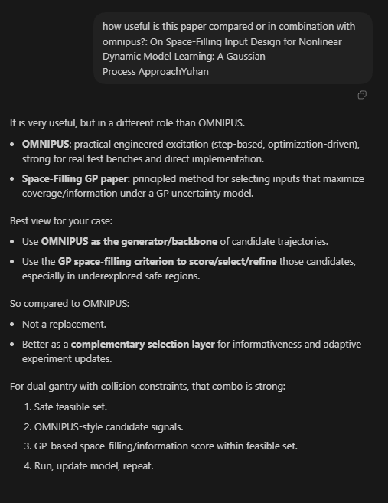
how useful is this paper compared or in combination with omnipus?: On Space-Filling Input Design for Nonlinear Dynamic Model Learning: A Gaussian Process ApproachYuhan

Slide 52
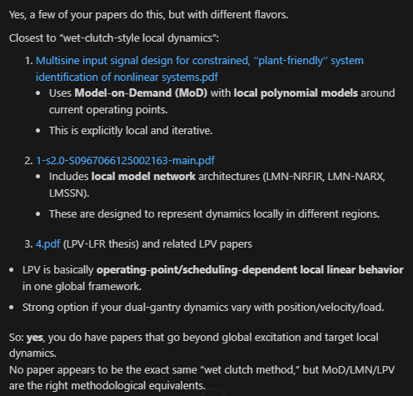
Similar to “Wet-Clutch trick”

Slide 53
Phase 1 Overview: Literature research
Deliverable Phase 1 ~6 weeks
  1. Background and already obtained results in the topic
  2. Literature survey
  3. Research questions
  4. AI&ES relevance
  5. Research methods
  6. Expected outcomes of the project
  7. Time planning phase 2
Phase 2
  Start simple; adapt Jan’s code to LPV and MIMO

Slide 54
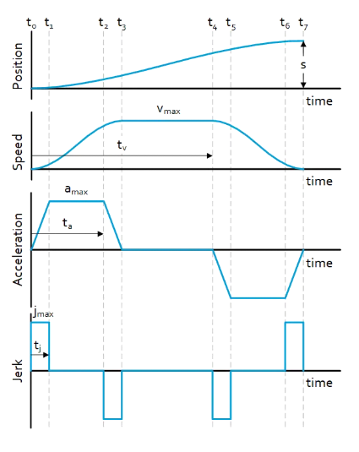
Outline next week
Start writing mockup for Phase 1 deliverable
Simulation
  Test MIMO
  Look into Roel Drenth his code for LPV?
Design experiment around settling error bound
  Reference trajectory / set point generator
  How to relate this to excitation

